Slide 1
Managed post-mortem: crashes, hangs and high CPU
Michael Yarichuk

Slide 2
Stuff we will take a look at
The what and why of post-mortem debugging
Tooling & debugging environment
Investigation strategy
Symptoms & root causes
Hands-on exercises!

Slide 3
So… why bother?

Slide 4

Why bother?
Production system runs for two month
User requests fail with timeouts. Now what?

Slide 5
Why bother?
Post-mortem Debugging
Hangs
Crashes
Resource saturation (CPU, memory, threads)

Slide 6
Why bother?
Issue happens in production
Issue is hard/impossible to reproduce
Most importantly: investigating dumps should be a last resort!!

Slide 7
The starting point
Tooling & debugging environment

Slide 8
Symbols
Public → minimal information
Private→ full information, easy debugging & reverse engineering
Some WinDBG commands like dv require private symbols
Symbol servers!
cache*d:\Symbols
srv*d:\Symbols*https://msdl.microsoft.com/download/symbols

Slide 9
Symbols
.symfix → set Microsoft symbol server in path
.sympath+ [path] → add path of local symbol sever
.reload → ensure symbols are loaded in debugger
https://docs.microsoft.com/en-us/windows-hardware/drivers/debugger/symbol-path

Slide 10
Windows Debugger (aka WinDBG)
WinDBG is based on Debugging Engine API
Other debuggers such as KD, NTSD and CDB interface with the same API
Can debug in user-mode & kernel mode
Supports live & post-mortem debugging

Slide 11
Windows Debugger - Extensions
SOS – Son Of Strike
.Net debugging
Each .NET version has it’s own SOS
SOSEX
Additional (very!) useful commands
Better versions of (some) SOS commands
NetExt
Additional commands, SQL-like queries
Complements SOS commands
https://github.com/rodneyviana/netext
http://www.stevestechspot.com/SOSEXV40NowAvailable.aspx

Slide 12
Additional useful tools
Perfview
Sysinternals tools (especially procdump)
DebugDiag
Dotnet CLI tools (tracing, monitoring)
Visual Studio’s Parallel Stacks
https://github.com/microsoft/perfview
https://www.microsoft.com/en-us/download/details.aspx?id=58210
https://github.com/dotnet/diagnostics/blob/master/documentation/design-docs/dotnet-tools.md

Slide 13
Dump “hunting” demo
Procdump, DebugDiag

Slide 14
Mini-dumps vs Full dumps (user-mode!)
Mini-dump → threads, stack traces, very small size
Full dumps → snapshot of process memory, typically large size
https://docs.microsoft.com/en-us/windows-hardware/drivers/debugger/user-mode-dump-files

Slide 15
We have the dump from production. Now what?
Investigation strategy

Slide 16
Dump Investigation
Start here!
(1) Theory
(3) Evidence!
(4) Make Changes
(5) Check If Resolved
(2) Investigation

Slide 17
1) Theory?
Symptoms
Theory

Slide 18
2) Investigation!
Multiple mini-dumps OR dumps
Perfview
ClrMD
Dashboards/tracing
https://github.com/microsoft/clrmd
https://github.com/microsoft/perfview

Slide 19
3) Evidence
Stack-traces of deadlocked threads including mutex address
A particular thread that is stuck on infinite loop
Huge amount of TPL tasks that have not run yet

Slide 20
4 & 5) Make changes & check if resolved
Make relevant changes (less allocations, remove references etc.)
It is possible that the original theory wasn't correct!
Rinse and repeat as needed

Slide 21
To sum it up
Investigation is not a precise science
It may and often will go in the wrong way!
Find the “smoking gun”

Slide 22
Now, let’s get more practical

Slide 23
Let’s start with threads

Slide 24
A word (or two) about threads
Thread → part of OS API
Two stacks, kernel and user-mode
Owns context, registers, exception data
Native threads cannot directly map to .Net threads
Threads in .Net → user-mode threads
Priority 1..31 (1..15 → normal, 16..31 → realtime)

Slide 25
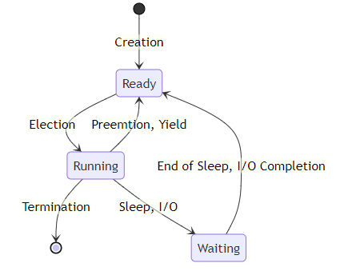
A word (or two) about threads - scheduling
Thread priorities are evil!
https://docs.microsoft.com/en-us/windows/win32/procthread/scheduling

Slide 26
Thin-locks & syncblocks
Managed locks start as user-mode “thin” locks
Viewed in WinDbg with !DumpHeap -thinlock
Promoted to kernel-mode locks (“fat” locks → syncblk) if
GetHashCode() is called
Lock contention from another thread
https://devblogs.microsoft.com/premier-developer/managed-object-internals-part-2-object-header-layout-and-the-cost-of-locking/

Slide 27
.Net Threadpool scaling
Try to prevent starvation with Hill Climbing heuristic
Will increase or decrease thread count in the pool
Can add threads either
Each 500 milliseconds
When work item (Task) finishes
http://www.danielmoth.com/Blog/New-And-Improved-CLR-4-Thread-Pool-Engine.aspx
https://mattwarren.org/2017/04/13/The-CLR-Thread-Pool-Thread-Injection-Algorithm/

Slide 28
Symptom: slowness
High thread contention for sync primitives
High GC rate
Thread starvation
Either threadpool starvation or thread priority starvation

Slide 29
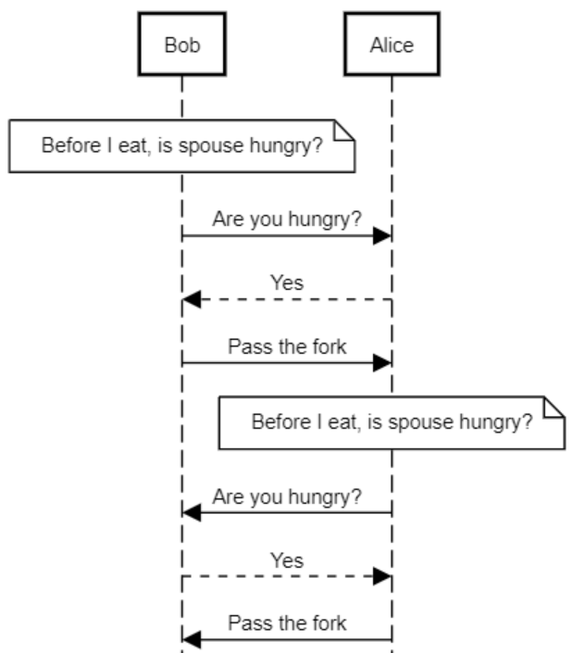
Livelock?

Slide 30
Symptom: hang/functionality stopped
Deadlock
“Outside” locks (e.g. file locks by anti-virus)
Infinite loops
Locked orphaned mutex
Livelock (rare!)

Slide 31
Summary – threading issues
Slowly working functionality, high CPU utilization and hangs are possible symptoms for threading issues
Narrow down possibilities by using monitoring/tracing
Starvation symptoms are easy to spot through monitoring
Starvation often happens with high CPU usage

Slide 32
Hands-on exercise 1
Threading issues

Slide 33
Symptom: sustained high CPU
“Expensive” computation
Infinite loops
(Very) high blocking GC rate
Thread Starvation (!!)
Spin-locks and any sync constructs that do it (for example - Monitor)

Slide 34
Symptom: sustained high CPU
Use monitoring to narrow down possibilities!
Usually happens TOGETHER with other symptoms
Usually this is not a problem by itself
Possible symptom of inefficiency
Possible symptom of thread starvation
Possible symptom of GC issues

Slide 35
Hands-on excecise 2
High CPU

Slide 36
Symptom:process crash
Unhandled (uncaught!) exceptions
Fatal Exceptions (StackoverflowException, AccessViolationException, etc)
https://youtu.be/U92Ts53win4

Slide 37
Symptom: process crash
StackoverflowException, AccessViolationException
Unless you throw them with ‘throw’ statement
P/Invoke with unhandled exceptions in native code
Any unhandled exceptions
https://github.com/dotnet/coreclr/blob/bbed8b0df6e43de80dbb6570b13bc79ffa01aad4/src/vm/excep.cpp#L7950
https://devblogs.microsoft.com/dotnet/how-clr-maps-seh-exceptions-to-managed-exception-types/

Slide 38
Hands-on excecise 3
Crashes

Slide 39
Summary
Post-mortem investigation is unpredictable time investment
Sometimes it is unavoidable
Each kind of failure may has one or more root causes
Investigating dumps requires experience but is not hard ☺

Slide 40
Additional reading materials
https://www.dumpanalysis.org/
http://chabster.blogspot.com/2013/07/a-story-of-orphaned-readerwriterlockslim.html
https://youtu.be/U92Ts53win4
https://medium.com/criteo-engineering/net-threadpool-starvation-and-how-queuing-makes-it-worse-512c8d570527
https://github.com/microsoft/vs-threading/blob/main/doc/threadpool_starvation.md
https://github.com/dotnet/coreclr/blob/bbed8b0df6e43de80dbb6570b13bc79ffa01aad4/src/vm/excep.cpp
https://github.com/anhkgg/awesome-windbg-extensions

Slide 41

Questions?
michael.yarichuk@gmail.com
@myarichuk
https://github.com/myarichuk
http://www.graymatterdeveloper.com/

